Slide 1
Limits of Experiments
Jaehyoung Hong

Slide 2
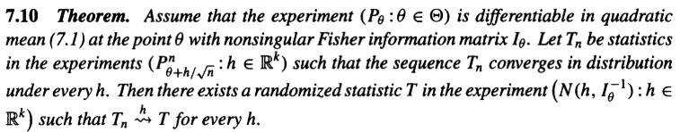
Convergence of “experiment”(model) to “limit experiment”
Definition of Experiment
$$(χ,𝒜 ,P_{h},h∈H)$$
where $\left(χ,𝒜\right):measurable space \left(sample space\right) \& P_{h}:Probability measure$
No sequence of statistical procedures can be asymptotically better than the "best" procedure in the limit experiment
A limit experiment explains the asymptotic behaviour of sequences of statistical procedures

Slide 3
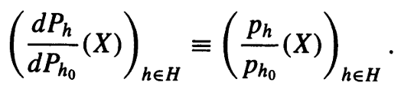
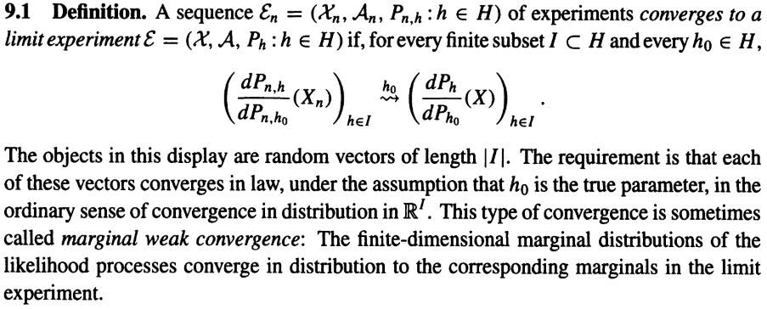
Convergence of finite sub-vectors of the likelihood process
Definition of likelihood process
where $h_{0}∈H:fixed parameter$
Marginal distributions of the likelihood ratio process of a limit experiment are unique
($∵$ Weak limit is unique)
But limit experiment itself is not unique

Slide 4


Sufficiency of equivalence between two likelihood process
Definition of equivalence between two experiments
$ε_{}^{1}\sim ε^{2}$ if marginal distributions of the likelihood ratio process are equal
Example of sufficiency of equivalence
If statistic $S:χ→𝓎$ is sufficient
$$\left(χ,𝒜 ,P_{h},h∈H\right)\sim (𝓎,𝒷,P_{h}∘S^{−1}:h∈H)$$
$∵$Neyman factorization criterion : $p_{h}\left(x\right)=g_{h}(S\left(x\right))f(x)$
$(N\left(Jh, J\right):h∈ℝ)\sim (N(h, J^{−1}):h∈ℝ)$ : $S=J$

Slide 5
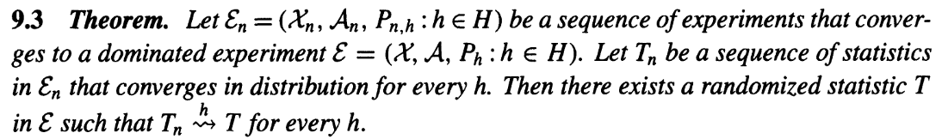
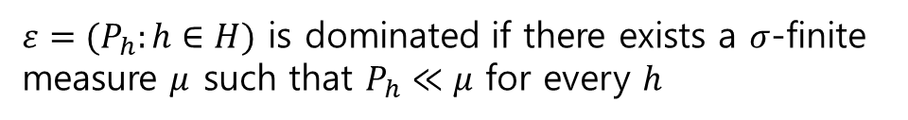
Asymptotic representation theorem
Definition of dominated experiment
$ε=(P_{h}:h∈H)$ is dominated if there exists a $σ$-finite measure $μ$ such that $P_{h}≪μ$ for every $h$
The limit experiment obtains the character of an asymptotic lower bound

Slide 6
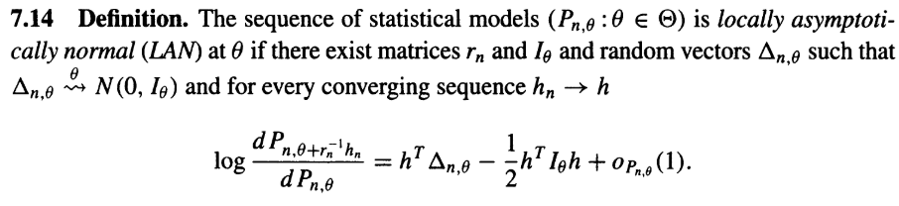
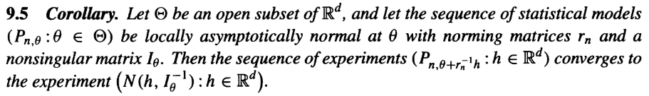
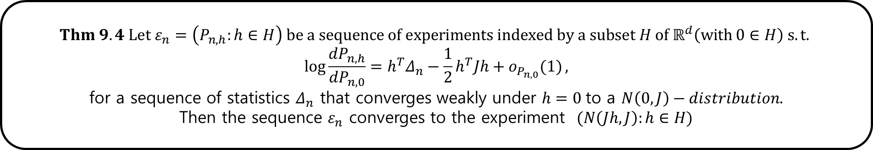
Asymptotic Normality
$$Thm 9.4 Let ε_{n}=\left(P_{n,h}:h∈H\right) be a sequence of experiments indexed by a subset H of ℝ^{d}\left(with 0∈H\right) s.t.$$
$$\log{\frac{dP_{n,h}}{dP_{n,0}}=h^{T}Δ_{n}−\frac{1}{2}h^{T}Jh+o_{P_{n,0}}(1)},$$
for a sequence of statistics $Δ_{n}$ that converges weakly under $h=0$to a $N\left(0,J\right)−distribution.$
Then the sequence $ε_{n}$ converges to the experiment $(N\left(Jh,J\right):h∈H)$

Slide 7
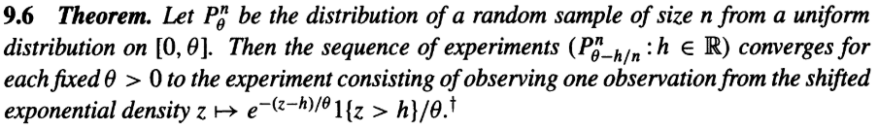
Uniform distribution has limit “exponential” experiment
In Ch 7, we showed that uniform distribution is not differentiable in quadratic mean
→ Asymptotic normal approximation is impossible
→ Exponential experiment
https://stats.stackexchange.com/questions/96216/find-the-exact-distribution-of-the-mle-estimator-and-n-theta-bar-theta-ex
It can be shown more generally that exponential limit experiments are obtained for any densities that have jumps at one or both of their endpoints and are smooth in between

Slide 8
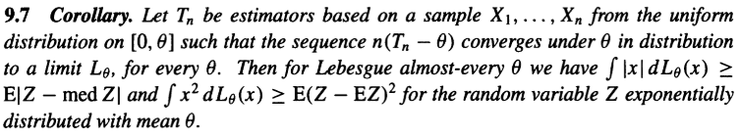
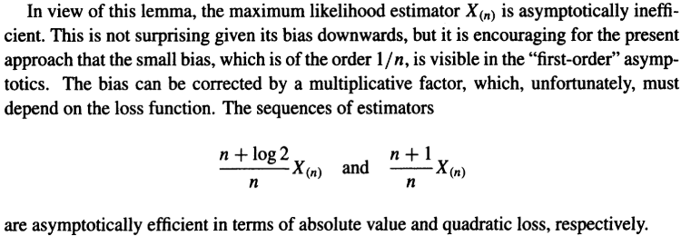
Asymptotic lower bounds of sequence of estimators

Slide 9
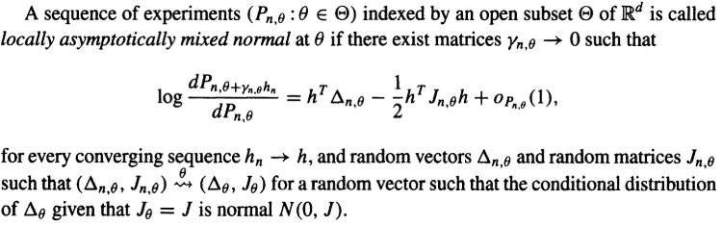
Locally asymptotically mixed normal (LAMN)
Definition of LAMN
Locally asymptotically normal (LAN) is the special case of LAMN when $J_{θ}$ is deterministic

Slide 10
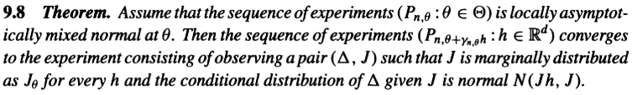
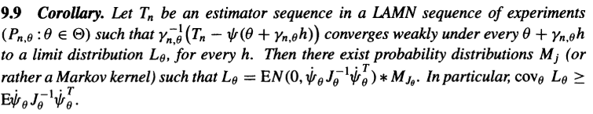
Limit experiments of LAMN

